Slide 1
Kubernetes
Kubernetes Up & Running
Part III
2026.08.25

Slide 2
HTTP Load Balancing with Ingress

Slide 3
Introduction(1/2)
HTTP-Based Service :
  A critical part of any application is getting network traffic to and from that application. Kubernetes has a set of capabilities to enable services to be exposed outside of the cluster. For many users and simple use cases these capabilities are sufficient.
  But the Service object operates at Layer 4 (according to the OSI model1). This means that it only forwards TCP and UDP connections and doesn’t look inside of those connections. Because of this, hosting many applications on a cluster uses many different exposed services. In the case where these services are type: “NodePort”, you’ll have to have clients connect to a unique port per service. In the case where these services are type: “LoadBalancer”, you’ll be allocating (often expensive or scarce) cloud resources for each service. But for “HTTP (Layer 7)-based services”, we can do better.
  When solving a similar problem in non-Kubernetes situations, users often turn to the idea of “virtual hosting.” This is a mechanism to host many HTTP sites on a single IP address. Typically, the user uses a load balancer or reverse proxy to accept incoming connections on HTTP (80) and HTTPS (443) ports. That program then parses the HTTP connection and, based on the Host header and the URL path that is requested, proxies the HTTP call to some other program. In this way, that load balancer or reverse proxy plays “traffic cop” for decoding and directing incoming connections to the right “upstream” server.

Slide 4
Introduction(2/2)
Ingress :
  Kubernetes calls its HTTP-based load-balancing system “Ingress”. Ingress is a Kubernetes-native way to implement the “virtual hosting” pattern. One of the more complex aspects of the pattern is that the user has to manage the load balancer configuration file. In a dynamic environment and as the set of virtual hosts expands, this can be very complex.
  The Kubernetes Ingress system works to simplify this by -
    Standardizing that configuration
    Moving it to a standard Kubernetes object
    Merging multiple Ingress objects into a single config for the load balancer
  The Ingress controller is a software system exposed outside the cluster using a service of type : “LoadBalancer”. It then proxies requests to “upstream” servers. The configuration for how it does this is the result of reading and monitoring “Ingress objects”.

Slide 5
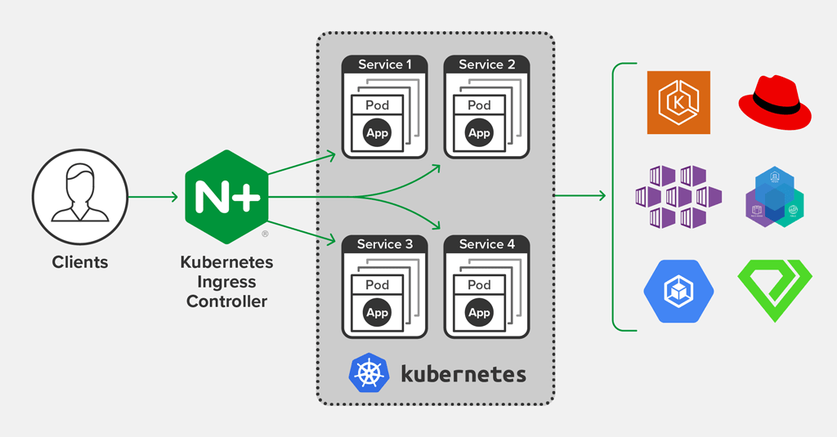
Ingress Spec. Versus Ingress Controllers
Ingress :
  Specifically, “Ingress” is split into a common resource specification and a controller implementation. There is no “standard” Ingress controller that is built into Kubernetes, so the user must install one of many optional implementations.
  Users can create and modify Ingress objects just like every other object. But, by default, there is no code running to actually act on those objects. It is up to the users (or the distribution they are using) to install and manage an outside controller. In this way, the controller is pluggable.
  The first reason is that there is no one single HTTP load balancer that can universally be used. In addition to many software load balancers (both open source and proprietary), there are also load-balancing capabilities provided by cloud providers (e.g., ELB on AWS), and hardware-based load balancers. The second reason is that the Ingress object was added to Kubernetes before any of the common extensibility capabilities were added. As Ingress progresses, it is likely that it will evolve to use these mechanisms.

Slide 6
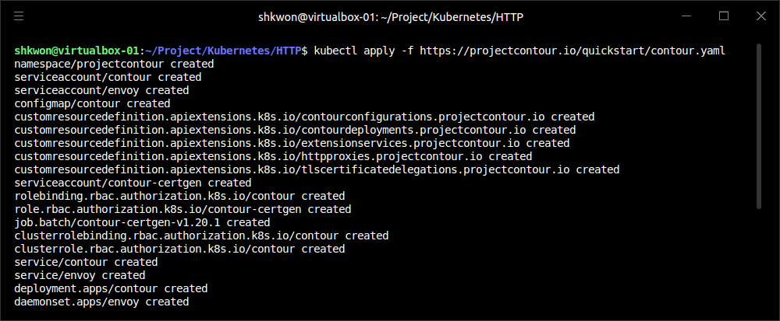
Installing Contour(1/2)
The Ingress Controller : Contour
  While there are many available Ingress controllers, for the examples here we use an Ingress controller called “Contour”. This is a controller built to configure the open source (and CNCF project) load balancer called “Envoy”. Envoy is built to be dynamically configured via an API. The “Contour Ingress controller” takes care of translating the “Ingress objects” into something that Envoy can understand.
  You can install Contour with the following command :
  Note : Before you run “kubectl apply -f …” command, make sure that minikube is running.
  The previous commands will create a namespace called “projectcontour”. Inside of that namespace it creates a “contour” and an “envoy”. In addition, it sets up the correct permissions via a service account and installs a “customresourceDefinition”.
$ minikube start
$ kubectl apply -f https://projectcontour.io/quickstart/contour.yaml

Slide 7
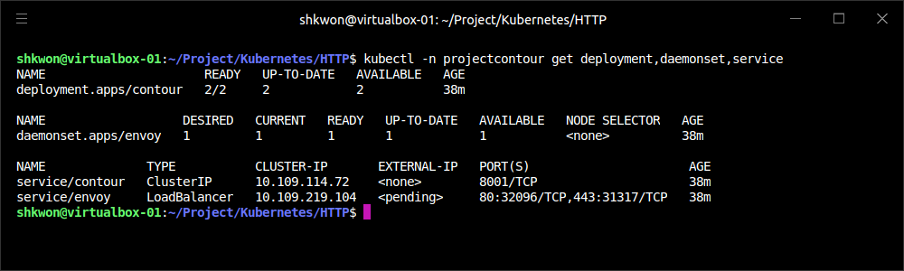
NOTE : Contour Installation
Project Contour :
  For more information, refer to https://tanzu.vmware.com/developer/guides/service-routing-contour-to-ingress-and-beyond/.
wget https://projectcontour.io/quickstart/v1.12.0/contour.yaml
less contour.yaml
kubectl apply -f contour.yaml --dry-run=client
kubectl apply -f contour.yaml
kubectl -n projectcontour get deployment,daemonset,service

Slide 8
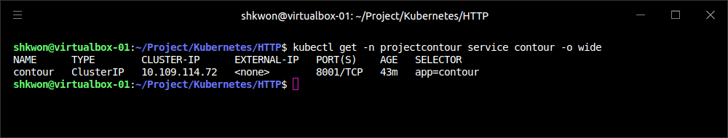
Installing Contour(2/2)
The Ingress Controller : Contour
  Because it is a global install, you need to ensure that you have wide admin permissions on the cluster you are installing into. After you install it, you can fetch the external address of Contour via :
  Look at the “EXTERNAL-IP” column. This can be either an IP address (for GCP and Azure) or a hostname (for AWS). Other clouds and environments may differ. If your Kubernetes cluster doesn’t support services of type: “LoadBalancer”, you’ll have to change the YAML for installing Contour to simply use type: “NodePort” and route traffic to machines on the cluster via a mechanism that works in your configuration.
  If you are using “minikube”, you probably won’t have anything listed for EXTERNAL-IP. To fix this, you need to open a separate terminal window and run “minikube tunnel”.
  This configures networking routes such that you have “unique IP addresses assigned to every service of type : LoadBalancer”.
$ kubectl get -n projectcontour service contour -o wide

Slide 9
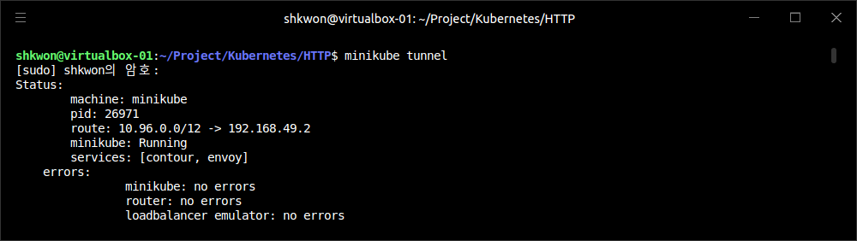
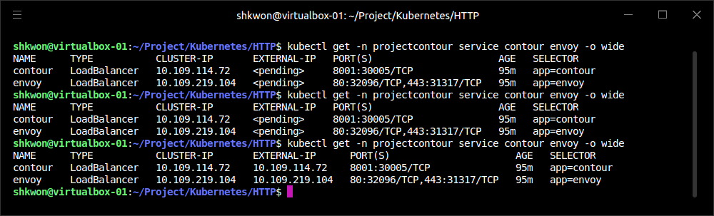
NOTE : Minikube Tunnel
Enable Tunneling :
  The “EXTERNAL-IP” Column shows the following screenshot after the “minikube tunnel” command.

Slide 10
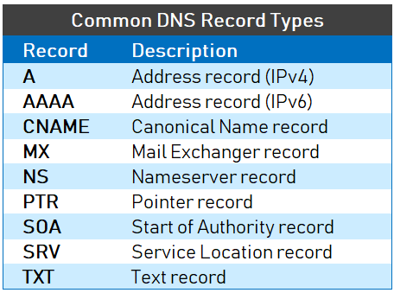
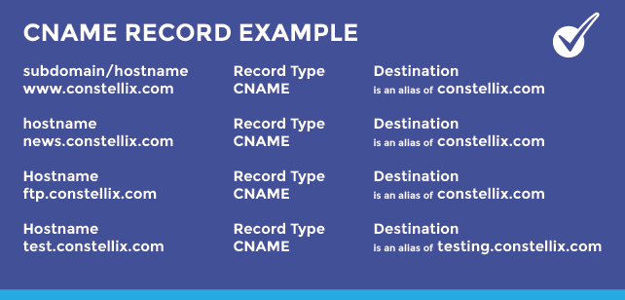
Configuring DNS
DNS Entry :
  To make Ingress work well, you need to configure DNS entries to the external address for your load balancer. You can map multiple hostnames to a single external endpoint and the Ingress controller will play traffic cop and direct incoming requests to the appropriate upstream service based on that hostname.
  We assume that you have a domain called “example.com”. You need to configure two DNS entries : “alpaca.example.com” and “bandicoot.example.com”. If you have an IP address for your external load balancer, you’ll want to create “A records”. If you have a hostname, you’ll want to configure “CNAME records”.

Slide 11
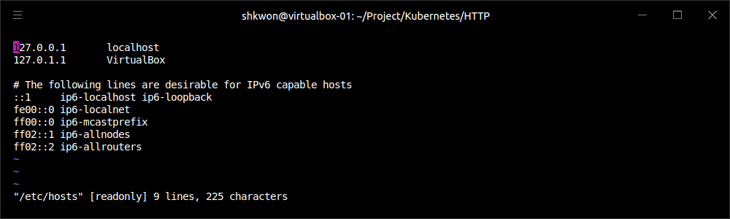
Configuring a Local “Hosts” File
IP Address Setting :
  If you don’t have a domain or if you are using a local solution such as “minikube”, you can set up a local configuration by editing your “/etc/hosts” file to add an IP address. You need “root(administrator)” privileges on your workstation. The location of the file may differ on your platform, and making it take effect may require extra steps. For example, on Windows the file is usually at “C:\Windows\System32\drivers\etc\hosts”, and for recent versions of MacOS you need to run “sudo killall -HUP mDNSResponder” after changing the file.
  Edit the file to add a line like the following :
  For “<ip-address>”, fill in the external IP address for Contour. If all you have is a hostname (like from AWS), you can get an IP address (that may change in the future) by executing “host -t a <address>”.
  NOTE : Don’t forget to undo these changes when you are done!
<ip-address> alpaca.example.com bandicoot.example.com

Slide 12
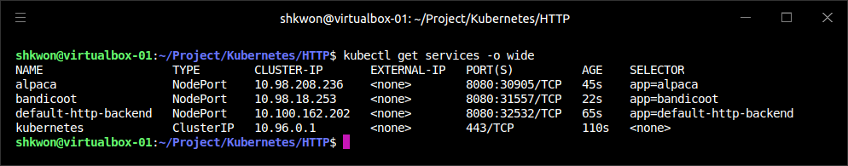
Using Ingress(1/11)
Creating Deployments :
  Now that we have an Ingress controller configured, let’s put it through its paces. First we’ll create a few upstream (also sometimes referred to as “backend”) services to play with by executing the following commands :
$ minikube start
$ kubectl create deployment default-http-backend \
--image=knix008/kuard-shkwon-amd64:1.0 \
--port=8080
$ kubectl expose deployment default-http-backend --type NodePort
$ kubectl create deployment alpaca \
--image=knix008/kuard-shkwon-amd64:1.0 \
--port=8080
$ kubectl expose deployment alpaca --type NodePort
$ kubectl create deployment bandicoot \
--image=knix008/kuard-shkwon-amd64:1.0 \
--port=8080
$ kubectl expose deployment bandicoot --type NodePort
$ kubectl get services -o wide

Slide 13
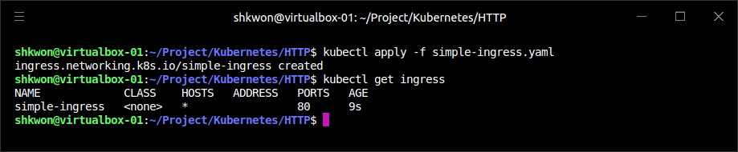
Using Ingress(2/11)
Simple Usage :
  The simplest way to use “Ingress” is to have it just blindly pass everything that it sees through to an upstream service. There is limited support for imperative commands to work with “Ingress” in “kubectl”, so we’ll start with a YAML file.
apiVersion: networking.k8s.io/v1
kind: Ingress
metadata:
name: simple-ingress
spec:
rules:
- http:
paths:
- path: /alpaca
pathType: Prefix
backend:
service:
name: alpaca
port:
number: 8080
simple-ingress.yaml(The Minimal Ingress YAML File)
$ kubectl apply -f simple-ingress.yaml

Slide 14
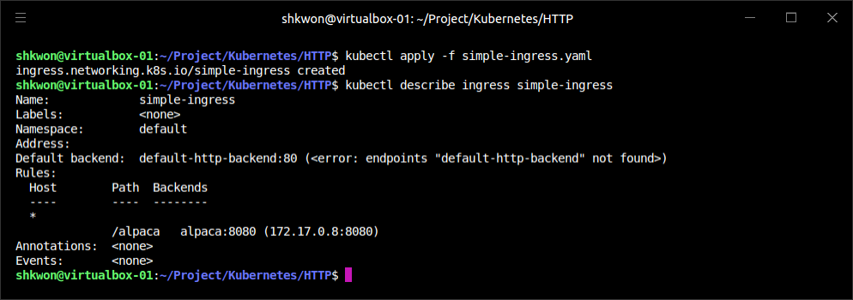
Using Ingress(3/11)
Simple Usage :
  You can verify that it was set up correctly using “kubectl get” and “kubectl describe” :
$ kubectl get ingress
$ kubectl describe ingress simple-ingress

Slide 15
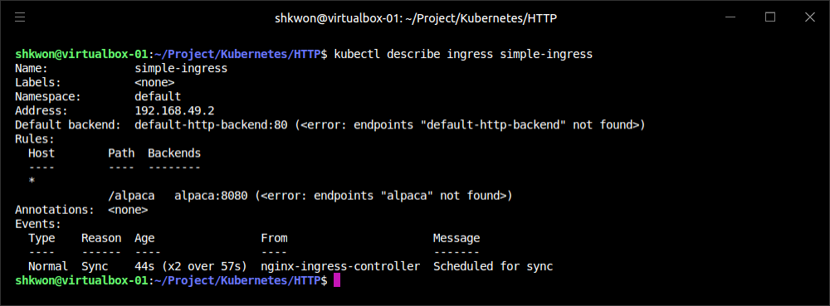
Using Ingress(4/11)
Simple Usage :
  The previous command sets things up so that any HTTP request that hits the Ingress controller is forwarded on to the “alpaca” service. You can now access the “alpaca” instance of “kuard” on any of the raw IPs/CNAMEs of the service; in this case, either “alpaca.example.com” or “bandicoot.example.com” which is configured in “/etc/hosts”.
  This doesn’t, at this point, add much value above a simple service of type: “LoadBalancer”(here we used “NodePort”).
  NOTE : If you enabled “Ingress” addon, you will see the following screen shot after “kubectl apply -f simple-ingress.yaml” command.

Slide 16
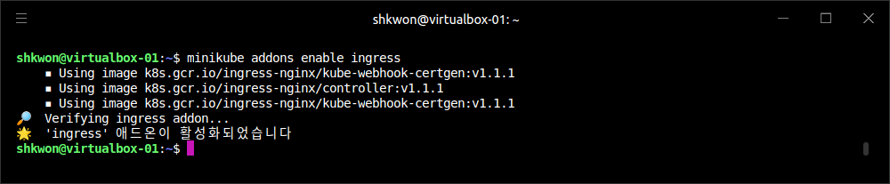
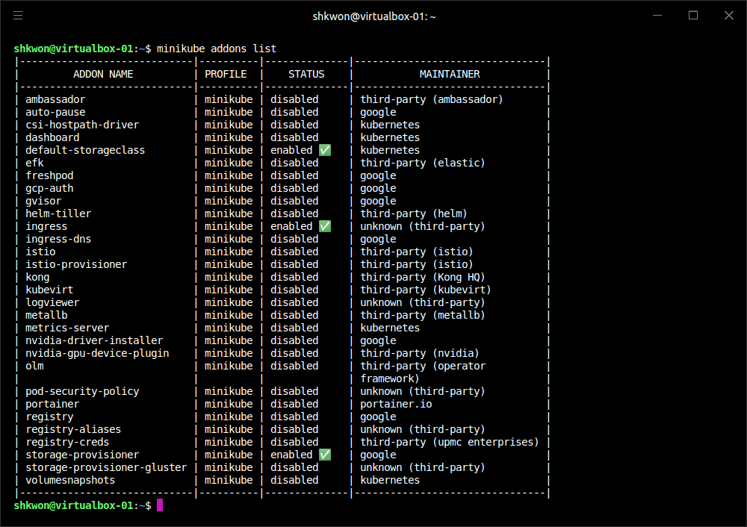
NOTE : Ingress Addons(1/2)
Enabling Ingress Addons :
  To enable Ingress addon, you can use the following command.
$ minikube addons enable ingress
  To see the all addons’ status, use “minikube addons list”.
  NOTE : If the enabling Ingress addon is timeout, then disable “swaping(sudo swapoff)” and reboot the system. Then do again from the “minikube start”.
  Trouble Shooting : If you cannot enable Ingress addon, try “minikube delete” and restart with “minikube start --driver=docker”. Then “minikube addons enable ingress”.

Slide 17
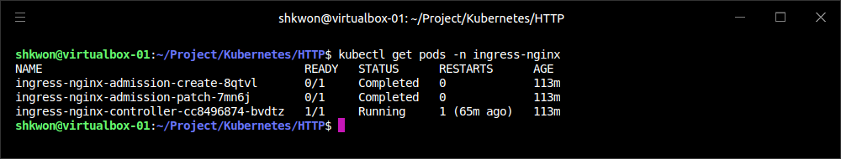
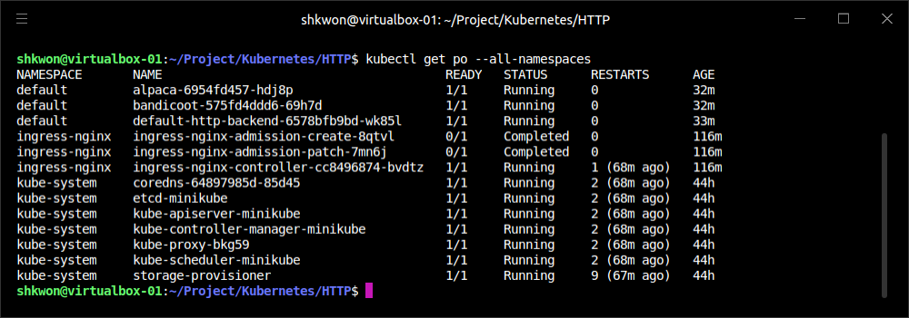
NOTE : Ingress Addons(2/2)
Checking the Ingress Addons :
  You can use “kubectl get pods” command to see the “Ingress” addons pods. Use the following command. As you can see, we are using “Nginx” ingress controller now.
kubectl get pods -n ingress-nginx

Slide 18
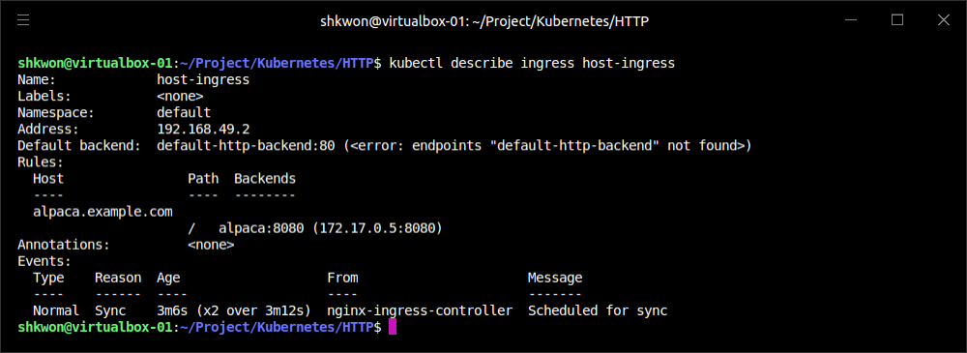
Using Ingress(5/11)
Using Hostnames :
  Things start to get interesting when we start to direct traffic based on properties of the request. The most common example of this is to have the Ingress system look at the HTTP host header (which is set to the DNS domain in the original URL) and direct traffic based on that header. Let’s add another Ingress object for directing traffic to the alpaca service for any traffic directed to “alpaca.example.com”.
$ kubectl apply -f host-ingress.yaml
host-ingress.yaml
apiVersion: networking.k8s.io/v1
kind: Ingress
metadata:
name: host-ingress
spec:
rules:
- host: alpaca.example.com
http:
paths:
- path: /
pathType: Prefix
backend:
service:
name: alpaca
port:
number: 8080

Slide 19
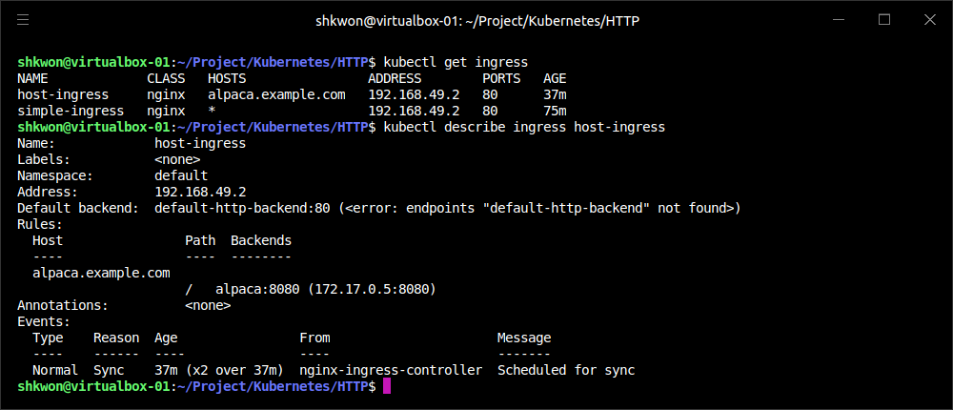
Using Ingress(6/11)
Using Hostnames :
  We can verify that things are set up correctly as follows :
$ kubectl get ingress
$ kubectl describe ingress host-ingress

Slide 20
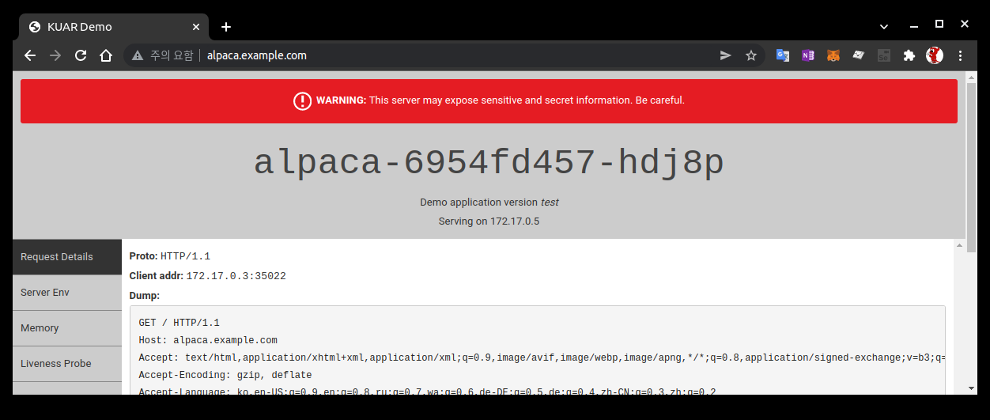
Using Ingress(7/11)
Using Hostnames :
  There is a reference to the “default-http-backend”. This is a convention that only some Ingress controllers use to handle requests that aren’t handled in any other way. These controllers send those requests to a service called “default-http-backend” in the “kube-system” namespace. This convention is surfaced client-side in “kubectl”.
  Now you should be able to address the alpaca service via “http://alpaca.example.com”. If instead you reach the service endpoint via other methods, you should get the default service.
  NOTE : Before you connect to the service, you need to edit “/etc/hosts” file to add IP address to the service. The IP address will be presented to you by “kubectl get ingress” command.

Slide 21
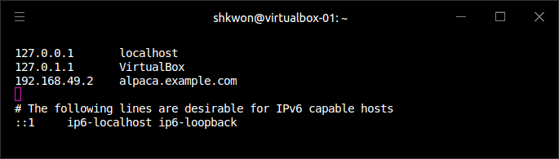
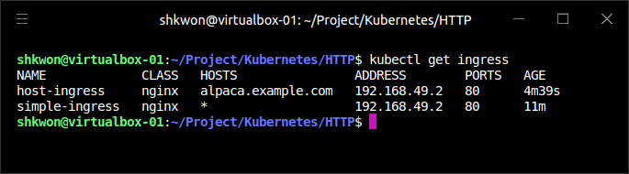
NOTE : Setting IP Address for Service
Linux Ubuntu 20.04 :
  See the following screenshot for setting the IP address for the service running in the Pods. After setting the IP address for the service, connect the service with your browser.
  NOTE : To get the IP address from the “kubectl get ingress”, you need to wait for several seconds.

Slide 22
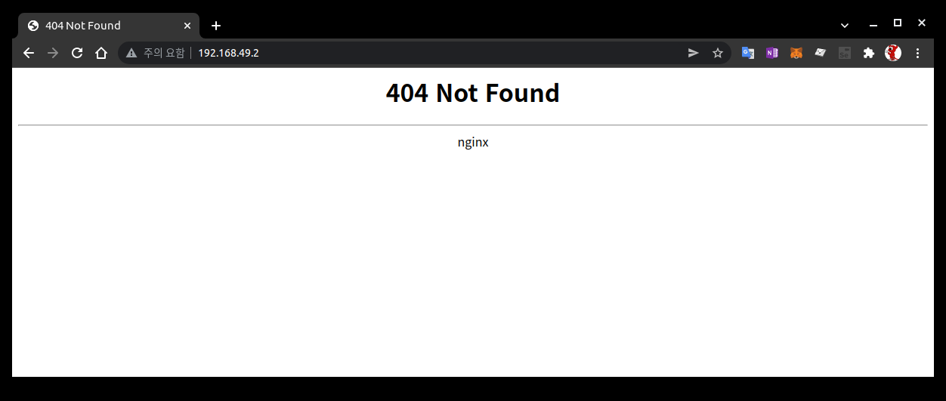
NOTE : Nginx Ingress Controller
Accessing “Nginx” :
  If you can access only “Ingress(Nginx Ingress)”, you can see the following screenshot. Use “http://<IP Address>” instead of hostname. It means the Ingress controller is working correctly.

Slide 23
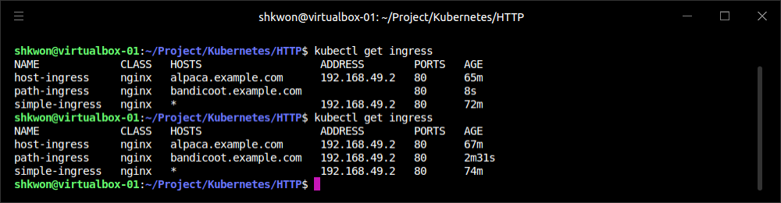
Using Ingress(8/11)
Using Paths :
  The next interesting scenario is to direct traffic based on not just the hostname, but also the path in the HTTP request. We can do this easily by specifying a path in the “paths” entry. In this example we direct everything coming into “http://bandicoot.example.com” to the “bandicoot” service, but we also send “http://bandicoot.example.com/alpaca” to the “alpaca” service. This type of scenario can be used to host multiple services on different paths of a single domain.
apiVersion: networking.k8s.io/v1
kind: Ingress
metadata:
name: path-ingress
spec:
rules:
- host: bandicoot.example.com
http:
paths:
- path: /
pathType: Prefix
backend:
service:
name: bandicoot
port:
number: 8080
- path: /a/
pathType: Prefix
backend:
service:
name: alpaca
port:
number: 8080
NOTE : Wait for a minute to get the IP address for “path-ingress”.
path-ingress.yaml

Slide 24
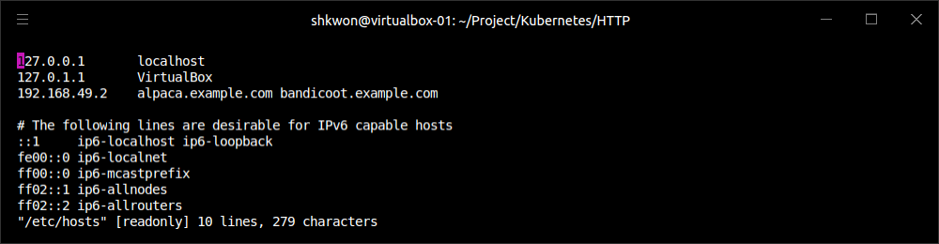
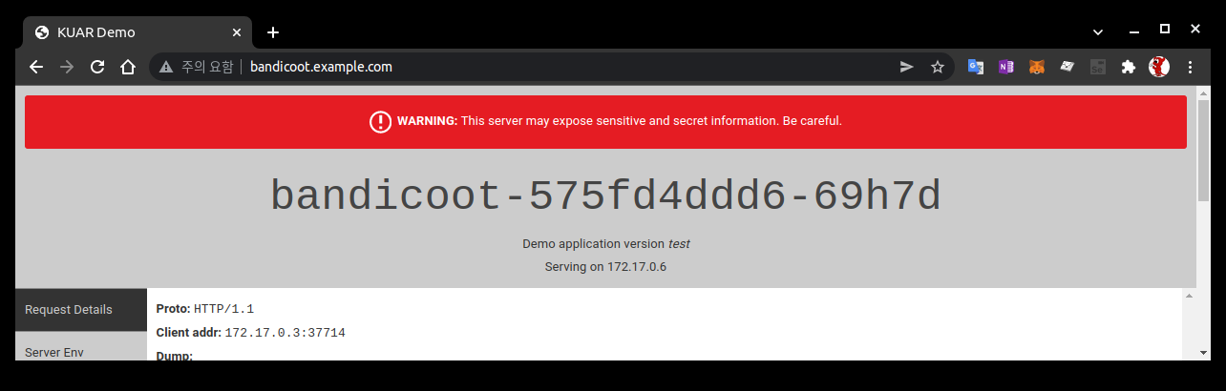
Using Ingress(9/11)
Using Paths :
  NOTE : Before you run the previous command, make sure your “/etc/hosts” file has “bandicoot.example.com”.

Slide 25
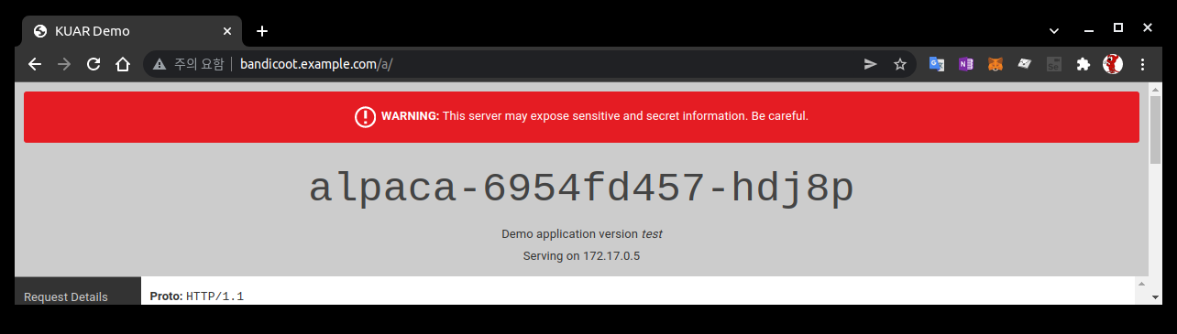
Using Ingress(10/11)
Using Paths :
  When there are multiple paths on the same host listed in the Ingress system, the longest prefix matches. So, in this example, traffic starting with “/a/” is forwarded to the “alpaca” service, while all other traffic (starting with “/”) is directed to the “bandicoot” service.
  As requests get proxied to the upstream service, the path remains unmodified. That means a request to “bandicoot.example.com/a/” shows up to the upstream server that is configured for that request hostname and path. The upstream service needs to be ready to serve traffic on that subpath. In this case, “kuard” has special code for testing, where it responds on the root path (“/”) along with a predefined set of subpaths (“/a/”, “/b/”, and “/c/”).
  NOTICE : Use “/a/” path for “alpaca” service in YAML file for this example.

Slide 26
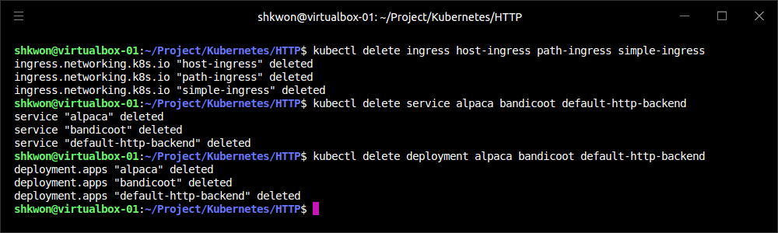
Using Ingress(11/11)
Cleaning Up :
  To clean up (ingress, service, deployment), execute the following commands :
  NOTE : If you want to remove IP addresses for the “xxx.example.com”, delete IP addresses for them in the “/etc/hosts” file.
$ kubectl delete ingress host-ingress path-ingress simple-ingress
$ kubectl delete service alpaca bandicoot default-http-backend
$ kubectl delete deployment alpaca bandicoot default-http-backend

Slide 27
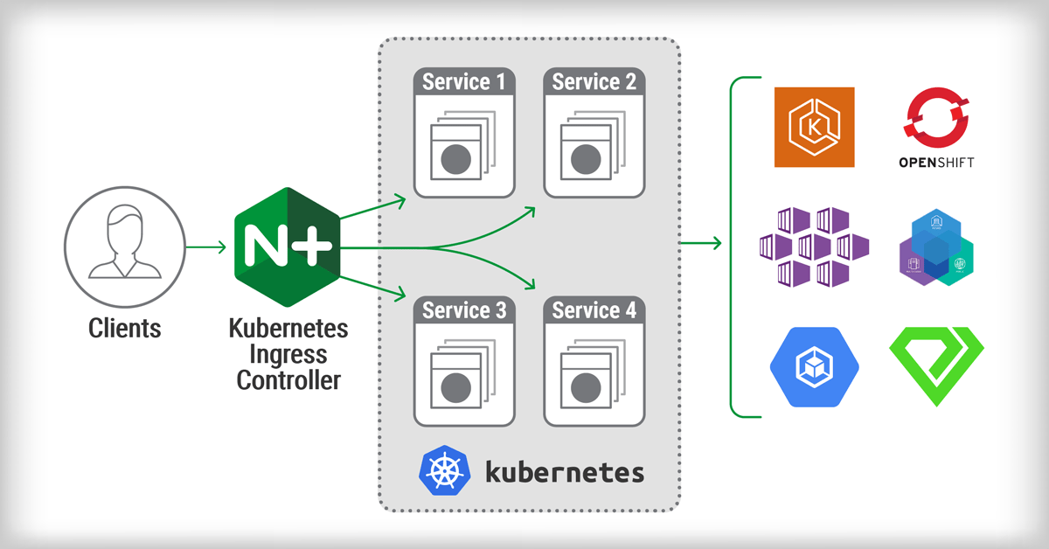
Advanced Ingress Topics and Gotchas(1/7)
Ingress Features :
  There are some other fancy features that are supported by Ingress. The level of support for these features differs based on the Ingress controller implementation, and two controllers may implement a feature in slightly different ways.
  Many of the extended features are exposed via “annotations” on the Ingress object. Be careful, as these annotations can be hard to validate and are easy to get wrong. Many of these annotations apply to the entire Ingress object and so can be more general than you might like. To scope the annotations down you can always split a single Ingress object into multiple Ingress objects. The Ingress controller should read them and merge them together.

Slide 28
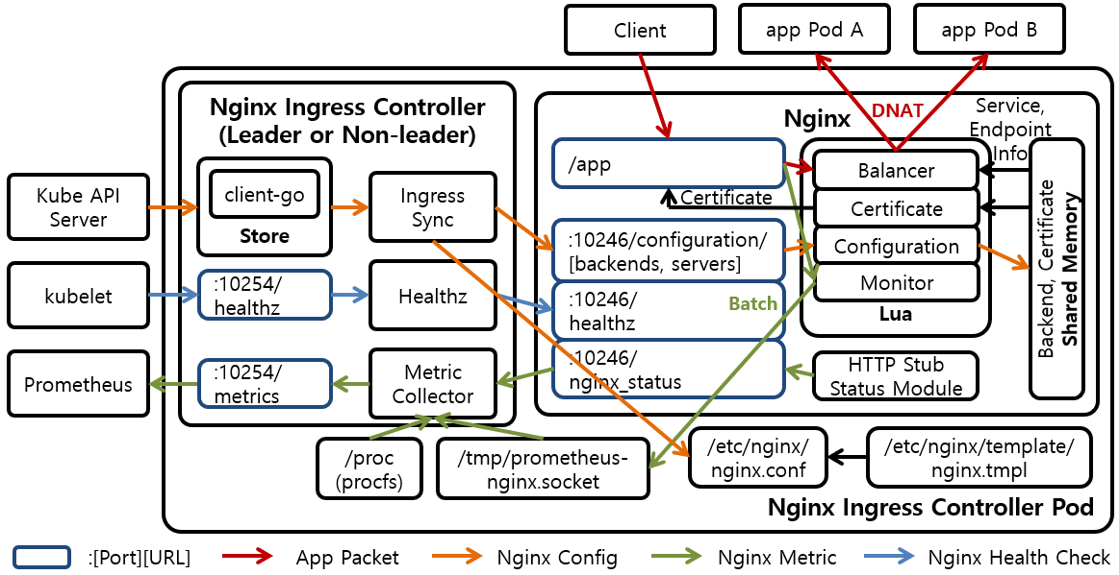
Advanced Ingress Topics and Gotchas(2/7)
Running Multiple Ingress Controllers :
  Oftentimes, you may want to run multiple Ingress controllers on a single cluster. In that case, you specify which Ingress object is meant for which Ingress controller using the “kubernetes.io/ingress.class” annotation. The value should be a string that specifies which Ingress controller should look at this object. The Ingress controllers themselves, then, should be configured with that same string and should only respect those Ingress objects with the correct annotation.
  If the “kubernetes.io/ingress.class” annotation is missing, behavior is undefined. It is likely that multiple controllers will fight to satisfy the Ingress and write the status field of the Ingress objects.

Slide 29
Advanced Ingress Topics and Gotchas(3/7)
Multiple Ingress Objects :
  If you specify multiple Ingress objects, the Ingress controllers should read them all and try to merge them into a coherent configuration. However, if you specify duplicate and conflicting configurations, the behavior is undefined. It is likely that different Ingress controllers will behave differently. Even a single implementation may do different things depending on nonobvious factors.

Slide 30
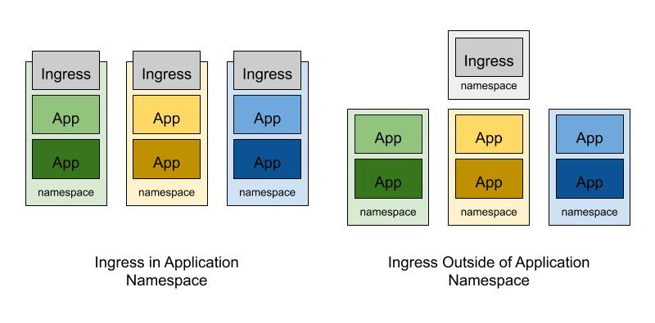
Advanced Ingress Topics and Gotchas(4/7)
Ingress and Namespaces :
  Ingress interacts with namespaces in some nonobvious ways. First, due to an abundance of security caution, an Ingress object can only refer to an upstream service in the same namespace. This means that you can’t use an Ingress object to point a subpath to a service in another namespace.
  However, multiple Ingress objects in different namespaces can specify subpaths for the same host. These Ingress objects are then merged together to come up with the final config for the Ingress controller. This cross-namespace behavior means that it is necessary that Ingress be coordinated globally across the cluster. If not coordinated carefully, an Ingress object in one namespace could cause problems (and undefined behavior) in other namespaces.
  Typically there are no restrictions built into the Ingress controller around what namespaces are allowed to specify what hostnames and paths. Advanced users may try to enforce a policy for this using a custom admission controller.

Slide 31
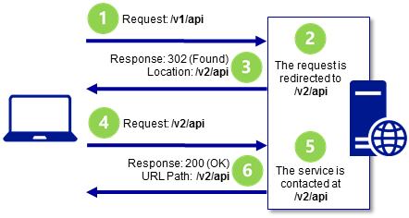
Advanced Ingress Topics and Gotchas(5/7)
Path Rewriting :
  Some Ingress controller implementations support, optionally, doing “path rewriting”. This can be used to modify the path in the HTTP request as it gets proxied. This is usually specified by an annotation on the Ingress object and applies to all requests that are specified by that object. For example, if we were using the NGINX Ingress controller, we could specify an annotation of “nginx.ingress.kubernetes.io/rewrite-target: /”. This can sometimes make upstream services work on a subpath even if they weren’t built to do so.
  There are multiple implementations that not only implement path rewriting, but also support regular expressions when specifying the path. For example, the NGINX controller allows regular expressions to capture parts of the path and then use that captured content when doing rewriting. How this is done (and what variant of regular expressions is used) is implementation-specific.
  Path rewriting isn’t a silver bullet, though, and can often lead to bugs. Many web applications assume that they can link within themselves using absolute paths. In that case, the app in question may be hosted on “/subpath” but have requests show up to it on “/”. It may then send a user to “/app-path”. There is then the question of whether that is an “internal” link for the app (in which case it should instead be “/subpath/app-path”) or a link to some other app. For this reason, it is probably best to avoid subpaths if you can help it for any complicated applications.

Slide 32
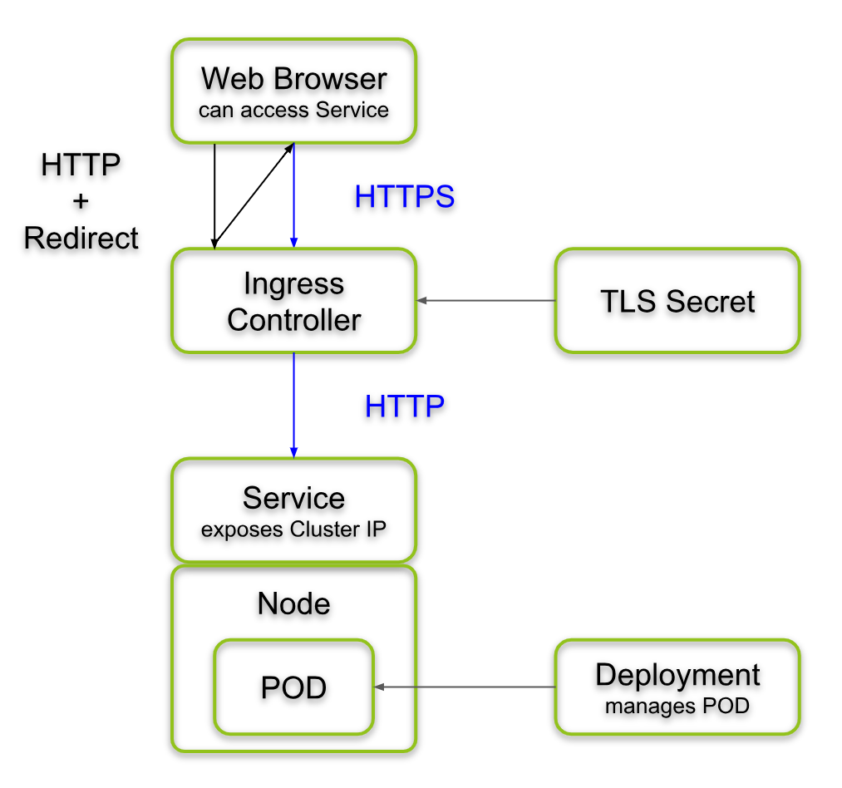
Advanced Ingress Topics and Gotchas(6/7)
Serving TLS :
  When serving websites, it is becoming increasingly necessary to do so securely using TLS and HTTPS. Ingress supports this (as do most Ingress controllers). First, users need to specify a secret with their TLS certificate and keys. You can also create a secret imperatively with “kubectl create secret tls <secret-name> --cert <certificate-pem-file> --key <private-key-pem-file>”.
apiVersion: v1
kind: Secret
metadata:
creationTimestamp: null
name: tls-secret-name
type: kubernetes.io/tls
data:
tls.crt: <base64 encoded certificate>
tls.key: <base64 encoded private key>
  NOTE : You need to check whether there is any update in the TLS support in Kubernetes.

Slide 33
Advanced Ingress Topics and Gotchas(7/7)
Serving TLS :
  Once you have the certificate uploaded, you can reference it in an Ingress object. This specifies a list of certificates along with the hostnames that those certificates should be used for. Again, if multiple Ingress objects specify certificates for the same hostname, the behavior is undefined.
  Uploading and managing TLS secrets can be difficult. In addition, certificates can often come at a significant cost. To help solve this problem, there is a non-profit called “Let’s Encrypt” running a free Certificate Authority that is API-driven. Since it is API-driven, it is possible to set up a Kubernetes cluster that automatically fetches and installs TLS certificates for you. The missing piece is an open source project called cert-manager initiated and supported by Jetstack, a UK startup.
apiVersion: networking.k8s.io/v1
kind: Ingress
metadata:
name: tls-ingress
spec:
tls:
- hosts:
- alpaca.example.com
secretName: tls-secret-name
rules:
- host: alpaca.example.com
http:
paths:
- path: /
pathType: Prefix
backend:
service:
name: alpaca
port:
number: 8080

Slide 34
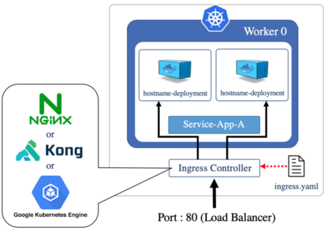
Alternate Ingress Implementations
Ingress Controllers :
  There are many different implementations of Ingress controllers, each building on the base Ingress object with unique features. First, each cloud provider has an Ingress implementation that exposes the specific cloud-based L7 load balancer for that cloud.
  Instead of configuring a software load balancer running in a Pod, these controllers take Ingress objects and use them to configure, via an API, the cloud-based load balancers. This reduces the load on the cluster and management burden for the operators, but can often come at a cost.
  The most popular generic Ingress controller is probably the open source NGINX ingress controller. Be aware that there is also a commercial controller based on the proprietary NGINX Plus. The open source controller essentially reads Ingress objects and merges them into an NGINX configuration file. It then signals to the NGINX process to restart with the new configuration (while responsibly serving existing inflight connections). The open NGINX controller has an enormous number of features and options exposed via “annotations”.
  Ambassador and Gloo are two other “Envoy-based Ingress controllers” that are focused on being API gateways. Traefik is a reverse proxy implemented in Go that also can function as an Ingress controller. It has a set of features and dashboards that are very developer-friendly. The Ingress ecosystem is very active and there are many new projects and commercial offerings that build on the humble Ingress object in unique ways.

Slide 35
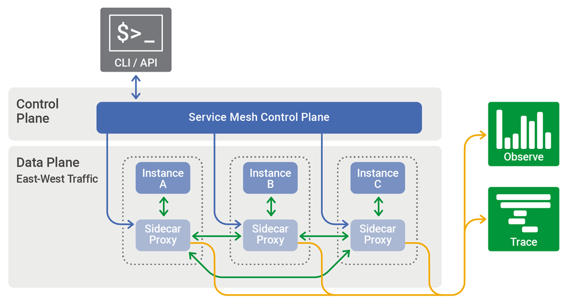
The Future of Ingress
Next Step? :
  The Ingress object provides a very useful abstraction for configuring L7 load balancers—but it hasn’t scaled to all the features that users want and various implementations are looking to offer.
  Many of the features in Ingress are underdefined. Implementations can surface these features in different ways, reducing the portability of configurations between implementations. Another problem is that it is easy to misconfigure Ingress. The way that multiple objects compose together opens the door for conflicts that are resolved differently by different implementations. In addition, the way that these are merged across namespaces breaks the idea of namespace isolation.
  Ingress was also created before the idea of a “Service Mesh” (exemplified by projects such as Istio and Linkerd) was well known. The intersection of Ingress and Service Meshes is still being defined.
  Istio implements the idea of a gateway that overlaps with Ingress in some ways. Contour introduces a new type called “IngressRoute” that is a better-defined and more explicit version of Ingress inspired by other network protocols like DNS.
  Defining the next step for Ingress is a hard problem. It involves creating a common language that applies to most load balancers, while at the same time leaving room for innovation of new features and allowing different implementations to specialize in other directions. This is an active area of innovation in the Kubernetes community through the Network Special Interest Group.

Slide 36
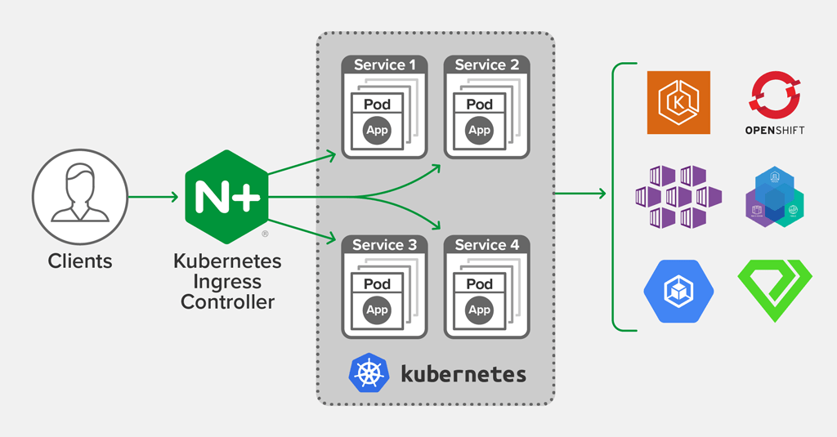
NOTE : Summary
Remember :
  Ingress is a unique system in Kubernetes. It is simply a schema, and the implementations of a controller for that schema must be installed and managed separately. But it is also a critical system for exposing services to users in a practical and cost-efficient way.
  As Kubernetes continues to mature, expect to see Ingress become more and more relevant.

Slide 37
ReplicaSets

Slide 38
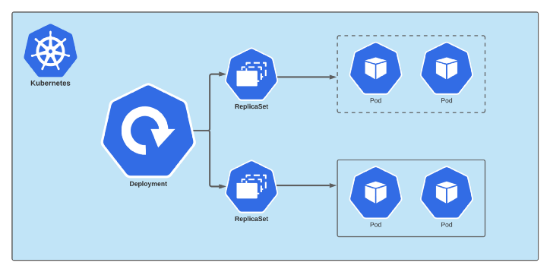
Introduction(1/2)
ReplicaSet :
  More often than not, you want multiple replicas of a container running at a particular time. There are a variety of reasons for this type of replication :
    Redundancy - Multiple running instances mean failure can be tolerated(Fault Tolerant).
    Scale - Multiple running instances mean that more requests can be handled.
    Sharding - Different replicas can handle different parts of a computation in parallel.
  Logically, a user managing a replicated set of Pods considers them as a “single entity” to be defined and managed. This is precisely what a ReplicaSet is. A ReplicaSet acts as a “cluster-wide Pod manager”, ensuring that the right types and number of Pods are running at all times.

Slide 39
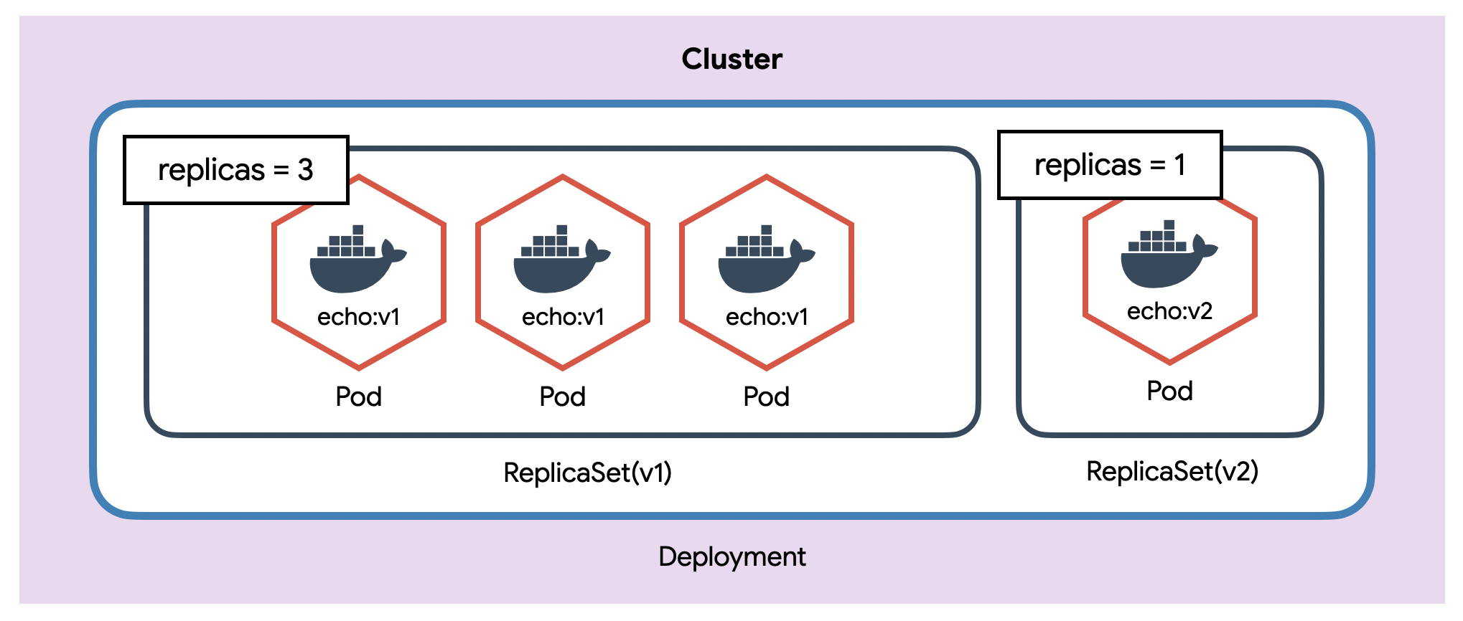
Introduction(2/2)
ReplicaSet :
  Because ReplicaSets make it easy to “create and manage replicated sets of Pods”, they are the building blocks used to describe common application deployment patterns and provide the underpinnings of “self-healing” for our applications at the infrastructure level. Pods managed by ReplicaSets are automatically rescheduled under certain failure conditions, such as node failures and network partitions.
  When we define a ReplicaSet, we define a specification for the Pods we want to create, and a desired number of replicas. Additionally, we need to define a way of finding Pods that the ReplicaSet should control..

Slide 40
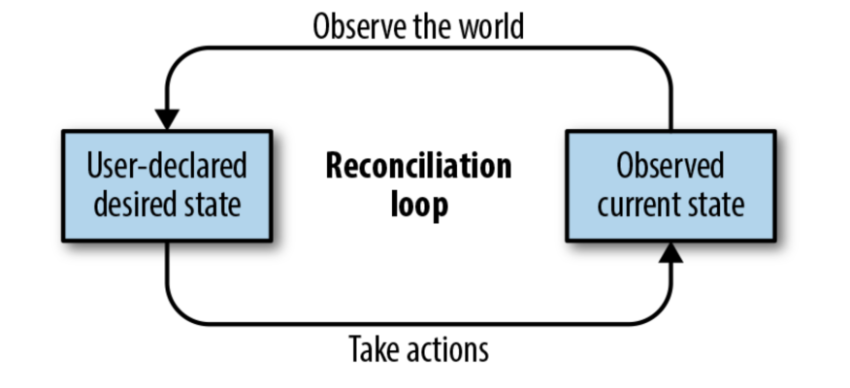
Reconciliation Loops
The Desired State vs. The Current(Observed) State :
  The central concept behind a reconciliation loop is “the notion of desired state versus observed or current state”. Desired state is the state you want. With a ReplicaSet, it is the desired number of replicas and the definition of the Pod to replicate. For example, “the desired state is that there are three replicas of a Pod running the kuard server.”
  In contrast, the current state is the currently observed state of the system. For example, “there are only two kuard Pods currently running.” The reconciliation loop is constantly running, observing the current state of the world and taking action to try to make the observed state match the desired state. For instance, with the previous examples, the reconciliation loop would create a new kuard Pod in an effort to make the observed state match the desired state of three replicas.
  There are many benefits to the reconciliation loop approach to managing state. It is an inherently goal-driven, self-healing system, yet it can often be easily expressed in a few lines of code(Infrastructure as a Code: IAAC).
  NOTE : The reconciliation loop for ReplicaSets is a single loop, yet it handles user actions to scale up or scale down the ReplicaSet as well as node failures or nodes rejoining the cluster after being absent.

Slide 41
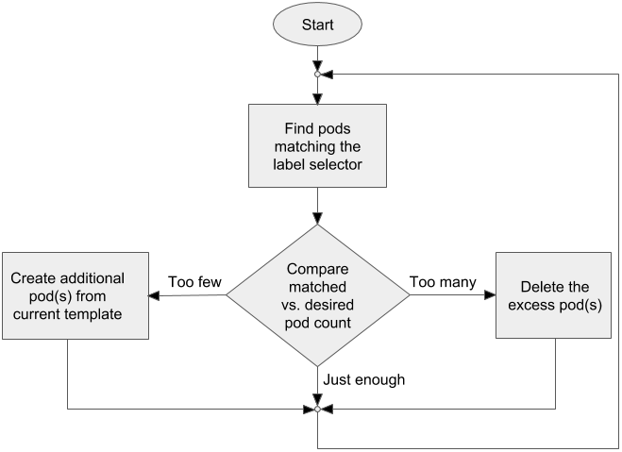
Relating Pods and ReplicaSets(1/3)
Decoupling :
  One of the key themes that runs through Kubernetes is decoupling. In particular, it’s important that all of the core concepts of Kubernetes are modular with respect to each other and that they are swappable and replaceable with other components.
  The relationship between ReplicaSets and Pods is loosely coupled. Though ReplicaSets create and manage Pods, they do not own the Pods they create. ReplicaSets use label queries to identify the set of Pods they should be managing. They then use the exact same Pod API that you used directly to create the Pods that they are managing. This notion of “coming in the front door” is another central design concept in Kubernetes.
  In a similar decoupling, ReplicaSets that create multiple Pods and the services that load-balance to those Pods are also totally separate, decoupled API objects.

Slide 42
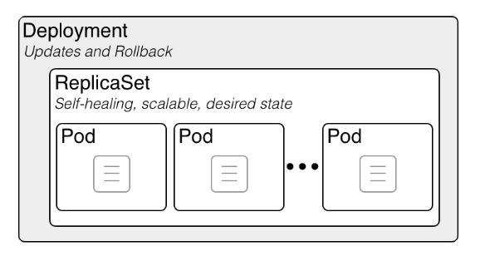
Relating Pods and ReplicaSets(2/3)
Adopting Existing Containers :
  Despite the value placed on declarative configuration of software, there are times when it is easier to build something up imperatively. In particular, early on you may be simply deploying a single Pod with a container image without a ReplicaSet managing it. At some point you may want to expand your singleton container into a replicated service and create and manage an array of similar containers. You may have even defined a load balancer that is serving traffic to that single Pod.
  If ReplicaSets owned the Pods they created, then the only way to start replicating your Pod would be to delete it and then relaunch it via a ReplicaSet. This might be disruptive, as there would be a moment in time when there would be no copies of your container running.
  However, because ReplicaSets are decoupled from the Pods they manage, you can simply create a ReplicaSet that will “adopt” the existing Pod, and scale out additional copies of those containers. In this way, you can seamlessly move from a single imperative Pod to a replicated set of Pods managed by a ReplicaSet.

Slide 43
Relating Pods and ReplicaSets(3/3)
Quarantining Containers :
  Oftentimes, when a server misbehaves, Pod-level health checks will automatically restart that Pod. But if your health checks are incomplete, a Pod can be misbehaving but still be part of the replicated set. In these situations, while it would work to simply kill the Pod, that would leave your developers with only logs to debug the problem.
  Instead, you can modify the set of labels on the “sick” Pod. Doing so will disassociate it from the ReplicaSet (and service) so that you can debug the Pod. The ReplicaSet controller will notice that a Pod is missing and create a new copy, but because the Pod is still running it is available to developers for interactive debugging, which is significantly more valuable than debugging from logs.

Slide 44
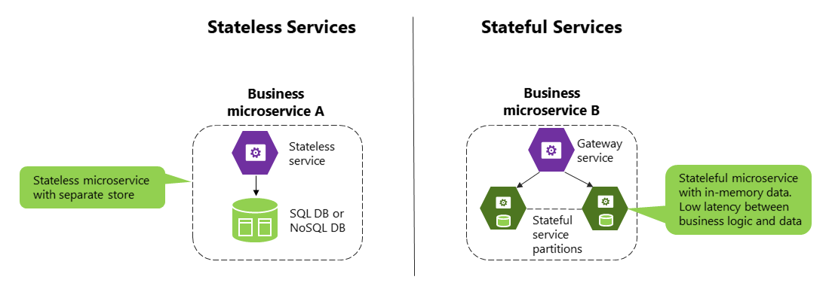
Designing with ReplicaSets
A Single, Scalable, Stateless Service :
  ReplicaSets are designed to represent “a single, scalable microservice“ inside your architecture. The key characteristic of ReplicaSets is that every Pod that is created by the ReplicaSet controller is entirely homogeneous. Typically, these Pods are then fronted by a Kubernetes service load balancer, which spreads traffic across the Pods that make up the service.
  Generally speaking, ReplicaSets are designed for “stateless (or nearly stateless) services”. The elements created by the ReplicaSet are interchangeable; when a ReplicaSet is scaled down, an arbitrary Pod is selected for deletion. Your application’s behavior shouldn’t change because of such a scale-down operation.

Slide 45
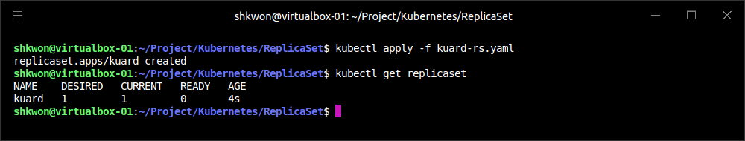
ReplicaSet Spec(1/3)
Specification :
  Like all objects in Kubernetes, ReplicaSets are defined using a specification. All ReplicaSets must have a unique name (defined using the metadata.name field), a spec section that describes the number of Pods (replicas) that should be running cluster-wide at any given time, and a Pod template that describes the Pod to be created when the defined number of replicas is not met.
  The following YAML file shows a minimal ReplicaSet definition.
apiVersion: apps/v1
kind: ReplicaSet
metadata:
name: kuard
spec:
replicas: 1
selector:
matchLabels:
app: kuard
template:
metadata:
labels:
app: kuard
version: "1"
spec:
containers:
- name: kuard
image: "knix008/kuard-shkwon-amd64:1.0"
kuard-rs.yaml

Slide 46
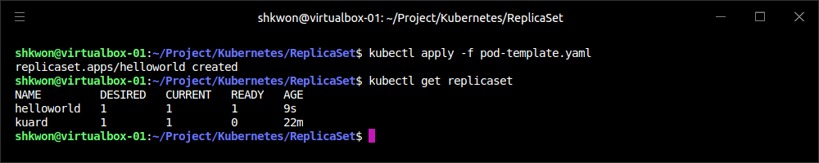
ReplicaSet Spec(2/3)
Pod Template :
  When the number of Pods in the current state is less than the number of Pods in the desired state, the ReplicaSet controller will create new Pods. The Pods are created using a Pod template that is contained in the ReplicaSet specification. The Pods are created in exactly the same manner as when you created a Pod from a YAML file, but instead of using a file, the Kubernetes ReplicaSet controller creates and submits a “Pod manifest” based on the “Pod template” directly to the API server.
  The following shows an example of a Pod template in a ReplicaSet :
apiVersion: apps/v1
kind: ReplicaSet
metadata:
name: helloworld
spec:
replicas: 1
selector:
matchLabels:
app: helloworld
template:
metadata:
labels:
app: helloworld
version: v1
spec:
containers:
- name: helloworld
image: kelseyhightower/helloworld:v1
ports:
- containerPort: 80

Slide 47
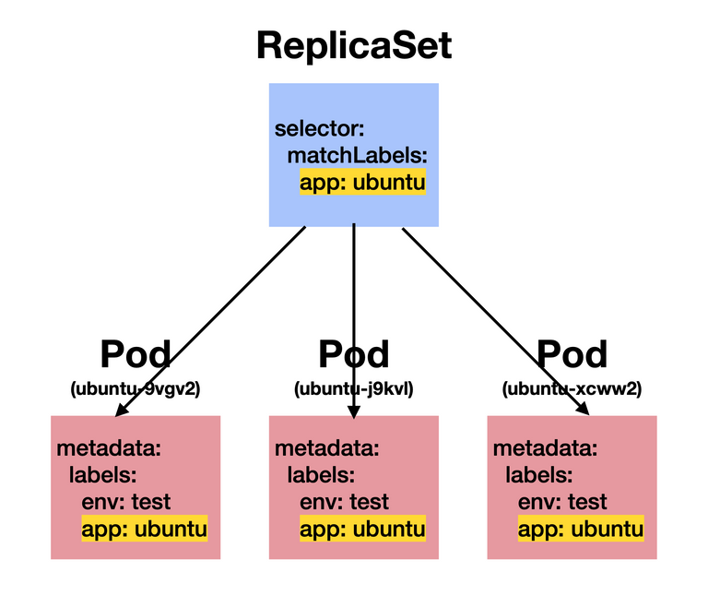
ReplicaSet Spec(3/3)
Labels :
  How does the ReplicaSet reconciliation loop discover the set of Pods for a particular ReplicaSet? ReplicaSets monitor cluster state using a set of “Pod labels”. Labels are used to filter Pod listings and track Pods running within a cluster. When initially created, a ReplicaSet fetches a Pod listing from the Kubernetes API and filters the results by labels. Based on the number of Pods returned by the query, the ReplicaSet deletes or creates Pods to meet the desired number of replicas. The labels used for filtering are defined in the “ReplicaSet spec section” and are the key to understanding how ReplicaSets work.
  NOTE : The selector in the ReplicaSet spec should be a proper subset of the labels in the Pod template.

Slide 48
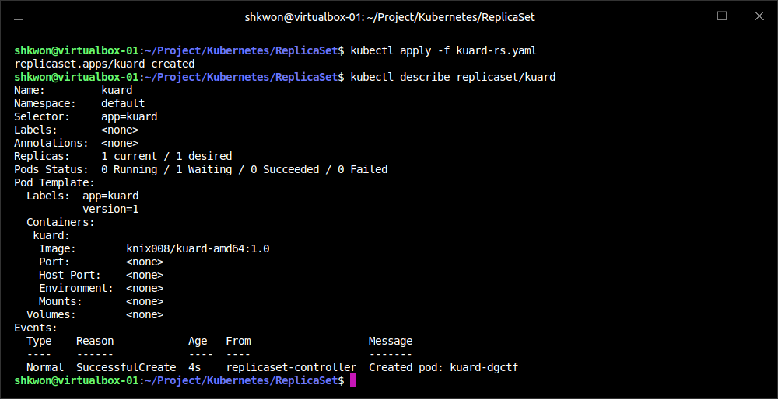
Creating a ReplicaSet(1/2)
ReplicaSet Object :
  ReplicaSets are created by submitting a ReplicaSet object to the Kubernetes API. The ReplicaSet configuration file will ensure one copy of the “knix008/kuard-shkwon-amd64:1.0” container is running at any given time.
  Use the “kubectl apply” command to submit the “kuard” ReplicaSet to the Kubernetes API :
$ kubectl apply -f kuard-rs.yaml

Slide 49
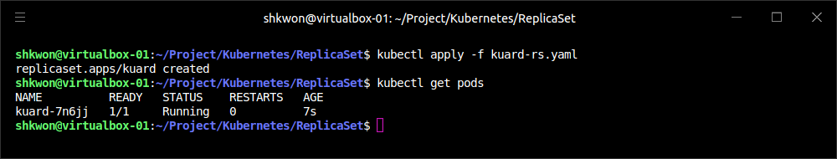
Creating a ReplicaSet(2/2)
ReplicaSet Object :
  Once the “kuard” ReplicaSet has been accepted, the ReplicaSet controller will detect that there are no “kuard” Pods running that match the desired state, and a new “kuard” Pod will be created based on the contents of the “Pod template” :
  NOTE : If the application image is not found in your system, then the “READY” field will be “0/1”. You need to prepare a docker image first before you make a ReplicaSet.

Slide 50
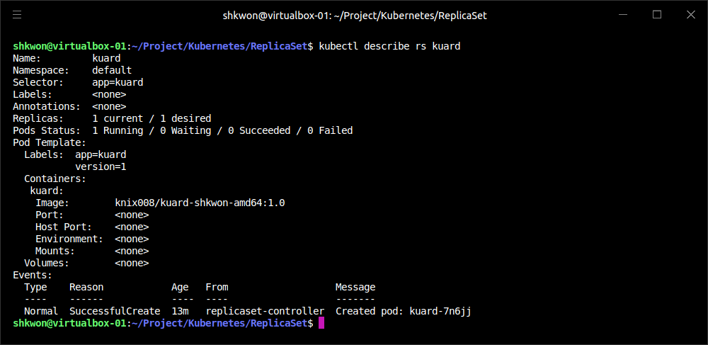
Inspecting a ReplicaSet(1/3)
Describe Command :
  As with Pods and other Kubernetes API objects, if you are interested in further details about a ReplicaSet, the “describe” command will provide much more information about its state. Here is an example of using “describe” to obtain the details of the “ReplicaSet(RS)” we previously created :
$ kubectl describe rs kuard

Slide 51
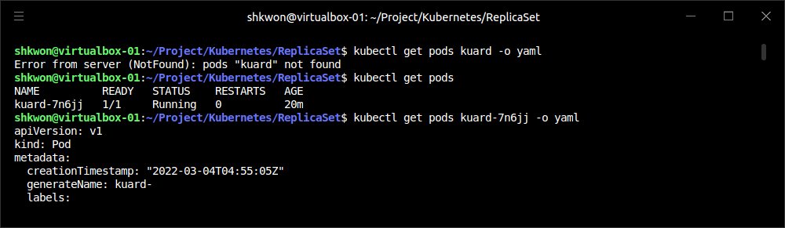
Inspecting a ReplicaSet(2/3)
Finding a ReplicaSet from a Pod :
  Sometimes you may wonder if a Pod is being managed by a ReplicaSet, and if it is, which ReplicaSet.
  To enable this kind of discovery, the ReplicaSet controller adds an annotation to every Pod that it creates. The key for the annotation is “kubernetes.io/created-by”. If you run the following command, look for the “kubernetes.io/created-by” entry in the annotations section :
  If applicable, this will list the name of the ReplicaSet that is managing this Pod.
  Note : Such annotations are best-effort; they are only created when the Pod is created by the ReplicaSet, and can be removed by a Kubernetes user at any time.
$ kubectl get pods <pod-name> -o yaml

Slide 52
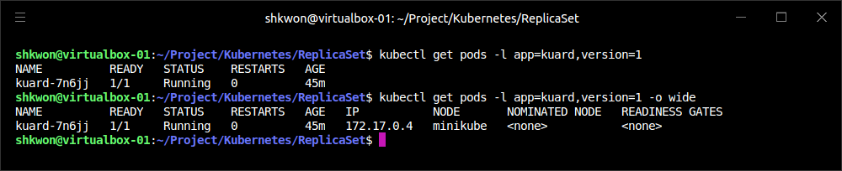
Inspecting a ReplicaSet(3/3)
Finding a Set of Pods for a ReplicaSet :
  You can also determine the set of Pods managed by a ReplicaSet. First, you can get the set of labels using the “kubectl describe” command. In the previous example, the label selector was “app=kuard,version=1”. To find the Pods that match this selector, use the “--selector” flag or the shorthand “-l” :
  This is exactly the same query that the ReplicaSet executes to determine the current number of Pods.
$ kubectl get pods -l app=kuard,version=1

Slide 53

Scaling ReplicaSets(1/8)
Scaling Up & Down :
  ReplicaSets are scaled up or down by updating the “spec.replicas” key on the ReplicaSet object stored in Kubernetes. When a ReplicaSet is scaled up, new Pods are submitted to the Kubernetes API using the “Pod template” defined on the ReplicaSet.

Slide 54

Scaling ReplicaSets(2/8)
Imperative Scaling with “kubectl scale” :
  The easiest way to achieve this is using the “scale” command in kubectl. For example, to scale up to four replicas you could run :
  While such imperative commands are useful for demonstrations and quick reactions to emergency situations (e.g., in response to a sudden increase in load), it is important to also update any text-file configurations to match the number of replicas that you set via the imperative scale command.
  NOTE : Ensure that any imperative changes are immediately followed by a declarative change in source control.
$ kubectl scale replicasets kuard --replicas=4

Slide 55

Scaling ReplicaSets(3/8)
Declaratively Scaling with “kubectl apply” :
  In a declarative world, we make changes by editing the configuration file in version control and then applying those changes to our cluster.
  To scale the “kuard” ReplicaSet, edit the “kuard-rs.yaml” configuration file and set the “replicas” count to 3 :
apiVersion: apps/v1
kind: ReplicaSet
metadata:
name: kuard
spec:
replicas: 3
selector:
matchLabels:
app: kuard
template:
metadata:
labels:
app: kuard
version: "1"
spec:
containers:
- name: kuard
image: "knix008/kuard-shkwon-amd64:1.0"

Slide 56

Scaling ReplicaSets(4/8)
Declaratively Scaling with “kubectl apply” :
  Now that the updated “kuard” ReplicaSet is in place, the ReplicaSet controller will detect that the number of desired Pods has changed and that it needs to take action to realize that desired state. If you used the imperative scale command in the previous section, the ReplicaSet controller will destroy one Pod to get the number to three. Otherwise, it will submit two new Pods to the Kubernetes API using the “Pod template” defined on the “kuard” ReplicaSet.
  Use the “kubectl get pods” command to list the running “kuard” Pods. :
$ kubectl get pods

Slide 57

Scaling ReplicaSets(5/8)
Autoscaling a ReplicaSet :
  While there will be times when you want to have explicit control over the number of replicas in a ReplicaSet, often you simply want to have “enough” replicas. The definition varies depending on the needs of the containers in the ReplicaSet.
  For example, with a web server like NGINX, you may want to scale due to CPU usage. For an in-memory cache, you may want to scale with memory consumption. In some cases you may want to scale in response to custom application metrics. Kubernetes can handle all of these scenarios via “Horizontal Pod Autoscaling (HPA)”.
  NOTE : HPA requires the presence of the “heapster” Pod on your cluster. heapster keeps track of metrics and provides an API for consuming metrics that HPA uses when making scaling decisions. Now the “heapster” is deprecated. It will not be installed together with kubernetes. You can validate its presence by listing the Pods in the “kube-system namespace” :
$ kubectl get pods --namespace=kube-system

Slide 58

Scaling ReplicaSets(6/8)
Autoscaling a ReplicaSet :
  “Horizontal Pod Autoscaling” is kind of a mouthful, and you might wonder why it is not simply called “autoscaling.” Kubernetes makes a distinction between “horizontal scaling”, which involves creating additional replicas of a Pod, and “vertical scaling”, which involves increasing the resources required for a particular Pod (e.g., increasing the CPU required for the Pod).

Slide 59

Scaling ReplicaSets(7/8)
Autoscaling Based on CPU :
  Scaling based on CPU usage is the most common use case for Pod autoscaling. Generally it is most useful for request-based systems that consume CPU proportionally to the number of requests they are receiving, while using a relatively static amount of memory.
  For example, to scale a ReplicaSet, you can run a command like the following :
  This command creates an “autoscaler” that scales between two and five replicas with a CPU threshold of 80%.
$ kubectl autoscale rs kuard --min=2 --max=5 --cpu-percent=80

Slide 60

Scaling ReplicaSets(8/8)
Autoscaling Based on CPU :
  To view, modify, or delete this resource you can use the standard kubectl commands and the “horizontalpodautoscalers” resource. “horizontalpodautoscalers” is quite a bit to type, but it can be shortened to “hpa” :
  NOTE : Because of the decoupled nature of Kubernetes, there is no direct link between the HPA and the ReplicaSet. While this is great for modularity and composition, it also enables some anti-patterns. In particular, it’s a bad idea to combine both autoscaling and imperative or declarative management of the number of replicas. If both you and an autoscaler are attempting to modify the number of replicas, it’s highly likely that you will clash, resulting in unexpected behavior.
$ kubectl get hpa

Slide 61

Deleting ReplicaSets(1/2)
Deleting ReplicaSet and Pods :
  When a ReplicaSet is no longer required it can be deleted using the “kubectl delete” command. By default, this also deletes the Pods that are managed by the ReplicaSet. Running the “kubectl get pods” command shows that all the “kuard” Pods created by the “kuard” ReplicaSet have also been deleted :
$ kubectl delete rs kuard
$ kubectl get pods

Slide 62


Deleting ReplicaSets(2/2)
Deleting ReplicaSet Only :
  If you don’t want to delete the Pods that are being managed by the ReplicaSet, you can set the “--cascade” flag to false to ensure only the ReplicaSet object is deleted and not the Pods :
$ kubectl delete rs kuard --cascade=false
$ kubectl get pods
Note : “--cascade=false” is deprecated. Use “--cascade=orphan” instead.

Slide 63

NOTE : Summary
Remember :
  Composing Pods with ReplicaSets provides the foundation for building robust applications with automatic failover, and makes deploying those applications a breeze by enabling scalable and sane deployment patterns.
  ReplicaSets should be used for any Pod you care about, even if it is a single Pod! Some people even default to using ReplicaSets instead of Pods. A typical cluster will have many ReplicaSets, so apply liberally to the affected area.

Slide 64
Deployments

Slide 65

What is Deployments?
Deployment Object and Controller :
  So far, you have seen how to package your applications as containers, create replicated sets of containers, and use Ingress controllers to load-balance traffic to your services. All of these objects (Pods, ReplicaSets, and Services) are used to build a single instance of your application. However, they do little to help you manage the daily or weekly cadence of releasing new versions of your application. Indeed, both Pods and ReplicaSets are expected to be tied to specific container images that don’t change.
  The Deployment object exists to manage the release of new versions. Deployments represent deployed applications in a way that transcends any particular version. Additionally, deployments enable you to easily move from one version of your code to the next. This “rollout” process is specifiable and careful. It waits for a user-configurable amount of time between upgrading individual Pods. It also uses health checks to ensure that the new version of the application is operating correctly, and stops the deployment if too many failures occur.
  Using deployments you can simply and reliably roll out new software versions without downtime or errors. The actual mechanics of the software rollout performed by a deployment is controlled by a “deployment controller” that runs in the Kubernetes cluster itself. This means you can let a deployment proceed unattended and it will still operate correctly and safely(Rolling Update). This makes it easy to integrate deployments with numerous continuous delivery(CD) tools and services. Further, running server-side makes it safe to perform a rollout from places with poor or intermittent internet connectivity. Imagine rolling out a new version of your software from your phone while riding on the subway. Deployments make this possible and safe!.

Slide 66

Your First Deployment(1/5)
Simple Deployment YAML :
  Like all objects in Kubernetes, a deployment can be represented as a declarative YAML object that provides the details about what you want to run. In the following case, the deployment is requesting a single instance of the “kuard” application : Use “$ kubectl create -f kuard-deployment.yaml” command to create a Deployment.
apiVersion: apps/v1
kind: Deployment
metadata:
name: kuard
spec:
selector:
matchLabels:
run: kuard
replicas: 1
template:
metadata:
labels:
run: kuard
spec:
containers:
- name: kuard
image: knix008/kuard-shkwon-amd64:1.0

Slide 67

Your First Deployment(2/5)
Deployment Internals :
  Let’s explore how deployments actually work. Just as we learned that ReplicaSets manage Pods, deployments manage ReplicaSets. As with all relationships in Kubernetes, this relationship is defined by labels and a label selector. You can see the label selector by looking at the Deployment object :
$ kubectl get deployments kuard -o jsonpath --template {.spec.selector.matchLabels}

Slide 68

Your First Deployment(3/5)
Deployment Internals :
  From this you can see that the deployment is managing a ReplicaSet with the label “run=kuard”. We can use this in a “label selector query” across ReplicaSets to find that specific ReplicaSet :
$ kubectl get replicasets --selector=run=kuard

Slide 69


Your First Deployment(4/5)
Deployment Internals :
  We can resize the deployment using the imperative “scale” command :
  Now if we list that ReplicaSet again, we should see :
$ kubectl scale deployments kuard --replicas=2
$ kubectl get replicasets --selector=run=kuard

Slide 70

Your First Deployment(5/5)
Deployment Internals :
  Scaling the deployment has also scaled the ReplicaSet it controls. Now let’s try the opposite, scaling the ReplicaSet :
  That’s odd. Despite our scaling the ReplicaSet to one replica, it still has two replicas as its desired state. What’s going on? Remember, Kubernetes is an online, self-healing system. The top-level Deployment object is managing this ReplicaSet. When you adjust the number of replicas to one, it no longer matches the desired state of the deployment, which has replicas set to 2. The deployment controller notices this and takes action to ensure the observed state matches the desired state, in this case readjusting the number of replicas back to two.
  If you ever want to manage that ReplicaSet directly, you need to delete the deployment (remember to set “--cascade to false”, or else it will delete the ReplicaSet and Pods as well!).
$ kubectl scale replicasets kuard-656679684f --replicas=1

Slide 71

Creating Deployments(1/2)
Declarative Management :
  Of course, as has been stated elsewhere, you should have a preference for declarative management of your Kubernetes configurations. This means maintaining the state of your deployments in YAML or JSON files on disk.
  As a starting point, download this deployment into a YAML file :
  NOTE : You need to run “kubectl replace --save-config” command. This adds an annotation so that, when applying changes in the future, “kubectl” will know what the last applied configuration was for smarter merging of configs. If you always use “kubectl apply”, this step is only required after the first time you create a deployment using “kubectl create -f”.
$ kubectl get deployments kuard -o yaml > kuard-deployment-saved.yaml
$ kubectl replace -f kuard-deployment-saved.yaml --save-config

Slide 72
Creating Deployments(2/2)
Declarative Management :
  The deployment spec has a very similar structure to the ReplicaSet spec. There is a Pod template, which contains a number of containers that are created for each replica managed by the deployment. In addition to the Pod specification, there is also a “strategy object” :
  The strategy object dictates the different ways in which a rollout of new software can proceed. There are two different strategies supported by deployments: “Recreate” and “RollingUpdate”.
…
spec:
progressDeadlineSeconds: 600
replicas: 2
revisionHistoryLimit: 10
selector:
matchLabels:
run: kuard
strategy:
rollingUpdate:
maxSurge: 25%
maxUnavailable: 25%
type: RollingUpdate
template:
metadata:
creationTimestamp: null
labels:
run: kuard
spec:
…
kuard-deployment-saved.yaml

Slide 73

Managing Deployments(1/2)
Get Detailed Information about a Deployment :
  As with all Kubernetes objects, you can get detailed information about your deployment via the “kubectl describe” command :

Slide 74

Managing Deployments(2/2)
Get Detailed Information about a Deployment :
  Two of the most important pieces of information in the output are “OldReplicaSets” and “NewReplicaSet”. These fields point to the ReplicaSet objects this deployment is currently managing. If a deployment is in the middle of a rollout, both fields will be set to a value. If a rollout is complete, “OldReplicaSets” will be set to “<none>”.
  In addition to the “describe” command, there is also the “kubectl rollout” command for deployments. You can use “kubectl rollout history” command to obtain the history of rollouts associated with a particular deployment. If you have a current deployment in progress, you can use “kubectl rollout status” command to obtain the current status of a rollout.
$ kubectl rollout history deployments kuard
$ kubectl rollout status deployments kuard

Slide 75
Updating Deployments(1/13)
Scaling a Deployment :
  Deployments are declarative objects that describe a deployed application. The two most common operations on a deployment are scaling and application updates.
  The best practice is to manage your deployments declaratively via the YAML files, and then use those files to update your deployment. To scale up a deployment, you would edit your YAML file to increase the number of replicas :
apiVersion: apps/v1
kind: Deployment
metadata:
name: kuard
spec:
selector:
matchLabels:
run: kuard
replicas: 3
template:
metadata:
labels:
run: kuard
spec:
containers:
- name: kuard
image: knix008/kuard-shkwon-amd64:1.0

Slide 76

Updating Deployments(2/13)
Scaling a Deployment :
  Once you have saved and committed this change, you can update the deployment using the “kubectl apply” command :
  This will update the desired state of the deployment, causing it to increase the size of the ReplicaSet it manages, and eventually create a new Pod managed by the deployment.
$ kubectl apply -f kuard-deployment.yaml

Slide 77
Updating Deployments(3/13)
Updating a Container Image :
  The other common use case for updating a deployment is to roll out a new version of the software running in one or more containers. To do this, you should likewise edit the deployment YAML file, though in this case you are updating the container image, rather than the number of replicas :
  We are also going to put an “annotation” in the template for the deployment to record some information about the update :
  NOTE : Make sure you add this annotation to the template and not the deployment itself, since the “kubectl apply” command uses this field in the Deployment object. Also, do not update the “change-cause annotation” when doing simple scaling operations. A modification of change-cause is a significant change to the template and will trigger a new rollout.
...
containers:
- image: knix008/kuard-shkwon-amd64:2.0
imagePullPolicy: Always
...
...
spec:
...
template:
metadata:
annotations:
kubernetes.io/change-cause: "Update to 2.0 kuard"
....

Slide 78
NOTE : The YAML File
Rollout YAML File :
  You can use the following updated “kuard-development-rollout.yaml” file for the “kubectl apply -f” command.
apiVersion: apps/v1
kind: Deployment
metadata:
name: kuard
spec:
selector:
matchLabels:
run: kuard
replicas: 3
template:
metadata:
annotations:
kubernetes.io/change-cause: "Update to 2.0 kuard"
labels:
run: kuard
spec:
containers:
- name: kuard
image: knix008/kuard-shkwon-amd64:2.0
imagePullPolicy: Always

Slide 79

NOTE : Build a Docker Image
Docker Image Build and Push :
  Before you run the previous examples, you need to build new docker image only for test in your local machine and push it into docker hub.
  NOTE : Use the image tag name, listed by “docker images” command, instead of the red string in the box.
mkdir kuard
git clone https://github.com/kubernetes-up-and-running/kuard.git
cd kuard
docker build -t kuard .
docker images
docker tag a0daf20aefbb knix008/kuard-shkwon-amd64:1.0
docker push knix008/kuard-shkwon-amd64:1.0

Slide 80

Updating Deployments(4/13)
Updating a Container Image :
  Again, you can use “kubectl apply” command to update the deployment :
$ kubectl apply -f kuard-deployment-rollout.yaml

Slide 81

Updating Deployments(5/13)
Updating a Container Image :
  After you update the deployment it will trigger a “rollout”, which you can then monitor via the “kubectl rollout” command :
  You can see the old and new ReplicaSets managed by the deployment along with the images being used. Both the old and new ReplicaSets are kept around in case you want to roll back:
$ kubectl rollout status deployments kuard
$ kubectl get replicasets -o wide

Slide 82

Updating Deployments(6/13)
Updating a Container Image :
  If you are in the middle of a rollout and you want to temporarily pause it for some reason (e.g., if you start seeing weird behavior in your system and you want to investigate), you can use the “pause” command :
  If, after investigation, you believe the rollout can safely proceed, you can use the “resume” command to start up where you left off :
$ kubectl rollout pause deployments kuard
$ kubectl rollout resume deployments kuard

Slide 83

Updating Deployments(7/13)
Rollout History :
  Kubernetes deployments maintain a history of rollouts, which can be useful both for understanding the previous state of the deployment and to roll back to a specific version.
  You can see the deployment history by running :
  The revision history is given in oldest to newest order. A unique revision number is incremented for each new rollout. So far we have two: the initial deployment, and the update of the image to “kuard:2.0”
$ kubectl rollout history deployment kuard

Slide 84

Updating Deployments(8/13)
Rollout History :
  If you are interested in more details about a particular revision, you can add the “--revision” flag to view details about that specific revision :
$ kubectl rollout history deployment kuard --revision=2

Slide 85

Updating Deployments(9/13)
Rollout History :
  Let’s do one more update for this example. Update the “kuard” version back to “1.0” by modifying the container version number and updating the “change-cause annotation”. Apply it with “kubectl apply -f” command. Our history should now have three entries :
$ kubectl apply -f kuard-deployment-rollback.yaml
$ kubectl rollout history deployment kuard

Slide 86
NOTE : The YAML File
Rollback YAML File :
  You can use the following updated “kuard-development-rollback.yaml” file for the “kubectl apply -f” command.
apiVersion: apps/v1
kind: Deployment
metadata:
name: kuard
spec:
selector:
matchLabels:
run: kuard
replicas: 3
template:
metadata:
annotations:
kubernetes.io/change-cause: "Rollback to 1.0 kuard"
labels:
run: kuard
spec:
containers:
- name: kuard
image: knix008/kuard-shkwon-amd64:1.0
imagePullPolicy: Always

Slide 87

Updating Deployments(10/13)
Rollout History :
  Let’s say there is an issue with the latest release and you want to roll back while you investigate. You can simply “undo” the last rollout :
  The “undo” command works regardless of the stage of the rollout. You can undo both partially completed and fully completed rollouts. An undo of a rollout is actually simply a rollout in reverse (e.g., from v2 to v1, instead of from v1 to v2), and all of the same policies that control the rollout strategy apply to the undo strategy as well.
$ kubectl rollout undo deployments kuard
$ kubectl rollout history deployment kuard

Slide 88

Updating Deployments(11/13)
Rollout History :
  The Deployment object simply adjusts the desired replica counts in the managed ReplicaSets :
  NOTE : When using declarative files to control your production systems, you want to, as much as possible, ensure that the checked-in manifests match what is actually running in your cluster. When you do a “kubectl rollout undo” you are updating the production state in a way that isn’t reflected in your source control. An alternative (and perhaps preferred) way to undo a rollout is to “revert your YAML file” and “kubectl apply” the previous version. In this way, your “change tracked configuration” more closely tracks what is really running in your cluster.
$ kubectl get replicasets -o wide

Slide 89

Updating Deployments(12/13)
Rollout History :
  When you look at the deployment history after “undo”, you can find that “revison #2” is missing. It turns out that when you roll back to a previous revision, the deployment simply reuses the template and renumbers it so that it is the latest revision. What was revision 2 before is now reordered into revision 4.
  We previously saw that you can use the “kubectl rollout undo” command to roll back to a previous version of a deployment. Additionally, you can roll back to a specific revision in the history using the “--to-revision” flag :
  Again, the undo took “revision #3”, applied it, and renumbered it as “revision #5”.
  Specifying a revision of “0” is a shorthand way of specifying the previous revision. In this way, “kubectl rollout undo” command is equivalent to “kubectl rollout undo --to-revision=0”.
$ kubectl rollout undo deployments kuard --to-revision=3
$ kubectl rollout history deployment kuard

Slide 90
Updating Deployments(13/13)
Rollout History :
  By default, the complete revision history of a deployment is kept attached to the Deployment object itself. Over time (e.g., years) this history can grow fairly large, so it is recommended that if you have deployments that you expect to keep around for a long time you set a maximum history size for the deployment revision history, to limit the total size of the Deployment object. For example, if you do a daily update you may limit your revision history to 14, to keep a maximum of 2 weeks’ worth of revisions (if you don’t expect to need to roll back beyond 2 weeks).
  To accomplish this, use the “revisionHistoryLimit” property in the deployment specification :
...
spec:
# We do daily rollouts, limit the revision history to two weeks of
# releases as we don't expect to roll back beyond that.
revisionHistoryLimit: 14
...

Slide 91

Deployment Strategies(1/14)
Rollout Strategy :
  When it comes time to change the version of software implementing your service, a Kubernetes deployment supports two different rollout strategies :
    Recreate
    RollingUpdate

Slide 92

Deployment Strategies(2/14)
Recreate Strategy :
  The Recreate strategy is the simpler of the two rollout strategies. It simply updates the ReplicaSet it manages to use the new image and terminates all of the Pods associated with the deployment. The ReplicaSet notices that it no longer has any replicas, and re-creates all Pods using the new image. Once the Pods are re-created, they are running the new version.
  While this strategy is fast and simple, it has one major drawback—it is potentially catastrophic, and will almost certainly result in some site downtime. Because of this, the Recreate strategy should only be used for test deployments where a service is not user-facing and a small amount of downtime is acceptable.

Slide 93

Deployment Strategies(3/14)
RollingUpdate Strategy :
  The RollingUpdate strategy is the generally preferable strategy for any user-facing service. While it is slower than Recreate, it is also significantly more sophisticated and robust. Using RollingUpdate, you can roll out a new version of your service while it is still receiving user traffic, without any downtime.
  As you might infer from the name, the RollingUpdate strategy works by updating a few Pods at a time, moving incrementally until all of the Pods are running the new version of your software.

Slide 94

Deployment Strategies(4/14)
RollingUpdate Strategy :
  Managing multiple versions of your service -
    Importantly, this means that for a period of time, both the new and the old version of your service will be receiving requests and serving traffic. This has important implications for how you build your software. Namely, it is critically important that each version of your software, and all of its clients, is capable of talking interchangeably with both a slightly older and a slightly newer version of your software.
You are in the middle of rolling out your frontend software; half of your servers are running version 1 and half are running version 2. A user makes an initial request to your service and downloads a client-side JavaScript library that implements your UI. This request is serviced by a version 1 server and thus the user receives the version 1 client library. This client library runs in the user’s browser and makes subsequent API requests to your service. These API requests happen to be routed to a version 2 server; thus, version 1 of your JavaScript client library is talking to version 2 of your API server. If you haven’t ensured compatibility between these versions, your application won’t function correctly.

Slide 95

Deployment Strategies(5/14)
RollingUpdate Strategy :
  Managing multiple versions of your service -
    Note that this doesn’t just apply to JavaScript clients—the same thing is true of client libraries that are compiled into other services that make calls to your service. Just because you updated doesn’t mean they have updated their client libraries. This sort of backward compatibility is critical to decoupling your service from systems that depend on your service. If you don’t formalize your APIs and decouple yourself, you are forced to carefully manage your rollouts with all of the other systems that call into your service. This kind of tight coupling makes it extremely hard to produce the necessary agility to be able to push out new software every week, let alone every hour or every day. In the “decoupled architecture”, the frontend is isolated from the backend via an API contract and a load balancer, whereas in the “coupled architecture”, a thick client compiled into the frontend is used to connect directly to the backends.
Decoupling
Coupling

Slide 96
Deployment Strategies(6/14)
RollingUpdate Strategy :
  Configuring a rolling update -
    RollingUpdate is a fairly generic strategy; it can be used to update a variety of applications in a variety of settings. Consequently, the rolling update itself is quite configurable; you can tune its behavior to suit your particular needs. There are two parameters you can use to tune the rolling update behavior: maxUnavailable and maxSurge.
    The maxUnavailable parameter sets the maximum number of Pods that can be unavailable during a rolling update. It can either be set to an absolute number (e.g., 3, meaning a maximum of three Pods can be unavailable) or to a percentage (e.g., 20%, meaning a maximum of 20% of the desired number of replicas can be unavailable).
    Generally speaking, using a percentage is a good approach for most services, since the value is correctly applicable regardless of the desired number of replicas in the deployment. However, there are times when you may want to use an absolute number (e.g., limiting the maximum unavailable Pods to one).

Slide 97

Deployment Strategies(7/14)
RollingUpdate Strategy :
  Configuring a rolling update -
    At its core, the maxUnavailable parameter helps tune how quickly a rolling update proceeds. For example, if you set maxUnavailable to 50%, then the rolling update will immediately scale the old ReplicaSet down to 50% of its original size. If you have four replicas, it will scale it down to two replicas. The rolling update will then replace the removed Pods by scaling the new ReplicaSet up to two replicas, for a total of four replicas (two old, two new). It will then scale the old ReplicaSet down to zero replicas, for a total size of two new replicas. Finally, it will scale the new ReplicaSet up to four replicas, completing the rollout. Thus, with maxUnavailable set to 50%, our rollout completes in four steps, but with only 50% of our service capacity at times.

Slide 98

Deployment Strategies(8/14)
RollingUpdate Strategy :
  Configuring a rolling update -
    Consider what happens if we instead set maxUnavailable to 25%. In this situation, each step is only performed with a single replica at a time and thus it takes twice as many steps for the rollout to complete, but availability only drops to a minimum of 75% during the rollout. This illustrates how maxUnavailable allows us to trade rollout speed for availability.
    NOTE : The observant among you will note that the “Recreate strategy” is identical to the “RollingUpdate strategy with maxUnavailable set to 100%”.

Slide 99

Deployment Strategies(9/14)
RollingUpdate Strategy :
  Configuring a rolling update -
    Using reduced capacity to achieve a successful rollout is useful either when your service has cyclical traffic patterns (e.g., much less traffic at night) or when you have limited resources, so scaling to larger than the current maximum number of replicas isn’t possible.
    However, there are situations where you don’t want to fall below 100% capacity, but you are willing to temporarily use additional resources in order to perform a rollout. In these situations, you can set the maxUnavailable parameter to “0%”, and instead control the rollout using the “maxSurge“ parameter. Like maxUnavailable, maxSurge can be specified either as a specific number or a percentage.

Slide 100

Deployment Strategies(10/14)
RollingUpdate Strategy :
  Configuring a rolling update -
    The maxSurge parameter controls how many extra resources can be created to achieve a rollout. To illustrate how this works, imagine we have a service with 10 replicas. We set maxUnavailable to “0” and maxSurge to “20%”. The first thing the rollout will do is scale the new ReplicaSet up to 2 replicas, for a total of 12 (120%) in the service. It will then scale the old ReplicaSet down to 8 replicas, for a total of 10 (8 old, 2 new) in the service. This process proceeds until the rollout is complete. At any time, the capacity of the service is guaranteed to be at least 100% and the maximum extra resources used for the rollout are limited to an additional 20% of all resources.
    NOTE : Setting maxSurge to 100% is equivalent to a “blue/green” deployment. The deployment controller first scales the new version up to 100% of the old version. Once the new version is healthy, it immediately scales the old version down to 0%.

Slide 101

Deployment Strategies(11/14)
Slowing Rollouts to Ensure Service Health :
  The purpose of a staged rollout is to ensure that the rollout results in a healthy, stable service running the new software version. To do this, the deployment controller always waits until a Pod reports that it is ready before moving on to updating the next Pod.
  NOTE : The deployment controller examines the Pod’s status as determined by its “readiness checks”. Readiness checks are part of the Pod’s “health probes”. If you want to use deployments to reliably roll out your software, you have to specify “readiness health checks” for the containers in your Pod. Without these checks, the deployment controller is running blind.

Slide 102

Deployment Strategies(12/14)
Slowing Rollouts to Ensure Service Health :
  Sometimes, however, simply noticing that a Pod has become ready doesn’t give you sufficient confidence that the Pod actually is behaving correctly. Some error conditions only occur after a period of time. For example, you could have a serious memory leak that takes a few minutes to show up, or you could have a bug that is only triggered by 1% of all requests. In most real-world scenarios, you want to wait a period of time to have high confidence that the new version is operating correctly before you move on to updating the next Pod.
  For deployments, this time to wait is defined by the “minReadySeconds” parameter :
  Setting “minReadySeconds” to 60 indicates that the deployment must wait for 60 seconds after seeing a Pod become healthy before moving on to updating the next Pod.
...
spec:
minReadySeconds: 60
...

Slide 103

Deployment Strategies(13/14)
Slowing Rollouts to Ensure Service Health :
  In addition to waiting a period of time for a Pod to become healthy, you also want to set a timeout that limits how long the system will wait. Suppose, for example, the new version of your service has a bug and immediately deadlocks. It will never become ready, and in the absence of a timeout, the deployment controller will stall your rollout forever.
  The correct behavior in such a situation is to “time out the rollout”. This in turn marks the rollout as failed. This failure status can be used to trigger alerting that can indicate to an operator that there is a problem with the rollout.
  NOTE : At first blush, timing out a rollout might seem like an unnecessary complication. However, increasingly, things like rollouts are being triggered by fully automated systems with little to no human involvement. In such a situation, timing out becomes a critical exception, which can either trigger an “automated rollback” of the release or “create a ticket/event” that triggers human intervention.

Slide 104
Deployment Strategies(14/14)
Slowing Rollouts to Ensure Service Health :
  To set the timeout period, the deployment parameter “progressDeadlineSeconds” is used :
  This example sets the progress deadline to 10 minutes. If any particular stage in the rollout fails to progress in 10 minutes, then the deployment is marked as failed, and all attempts to move the deployment forward are halted.
  NOTE : This timeout is given in terms of deployment progress, not the overall length of a deployment. In this context, progress is defined as any time the deployment creates or deletes a Pod. When that happens, the timeout clock is reset to zero. The following figure is an illustration of the deployment lifecycle.
...
spec:
progressDeadlineSeconds: 600
...

Slide 105

Deleting a Deployment
Deleting a Deployment, the Entire Service and ReplicaSets :
  If you ever want to delete a deployment, you can do it either with the imperative command :
  or using the declarative YAML file we created earlier :
  In either case, by default, deleting a deployment deletes the entire service. It will delete not just the deployment, but also any ReplicaSets being managed by the deployment, as well as any Pods being managed by the ReplicaSets. As with ReplicaSets, if this is not the desired behavior, you can use the “--cascade=false” flag to exclusively delete the Deployment object.
$ kubectl delete deployments kuard
$ kubectl delete -f kuard-deployment.yaml

Slide 106

NOTE : Deleting a Deployment
Using the Declarative YAML File :
  You can use the YAML file used for creating a deployment to delete a deployment. See the following screenshot.

Slide 107

Monitoring a Deployment
Deployment Status :
  When it comes to a deployment, it is important to note that if it fails to makes progress after a certain amount of time, the deployment will time out. When this happens, the status of the deployment will transition to a failed state. This status can be obtained from the “status.conditions” array, where there will be a “Condition” whose “Type” is “Progressing” and whose “Status” is “False”. A deployment in such a state has failed and will not progress further.
  To set how long the deployment controller should wait before transitioning into this state, use the “spec.progressDeadlineSeconds” field.

Slide 108
NOTE : Summary
Remember :
  At the end of the day, the primary goal of Kubernetes is to make it easy for you to build and deploy reliable distributed systems. This means not just instantiating the application once, but managing the regularly scheduled rollout of new versions of that software service.
  Deployments are a critical piece of reliable rollouts and rollout management for your services.

Slide 109

NOTE : CI/CD with Kubernetes
Continuous Integration & Continuous Delivery :
  The Blue and Green Deployments.

Slide 110

Reference
[1] Kubernetes: Up and Running, Dive into the Future of Infrastructure, Brendan Burns, Joe Beda, and Kelsey Hightower, Oreilly, 2nd Edition, 2019.
[2] https://github.com/kubernetes-up-and-running/kuard
[3] https://projectcontour.io/
[4] https://kubernetes.io/ko/docs/concepts/services-networking/ingress/
[5] https://kubernetes.io/ko/docs/tasks/access-application-cluster/ingress-minikube/

Slide 111

? & !

